Slide 1
Solar Energy

Slide 2
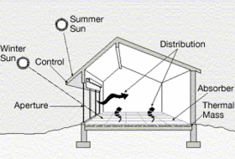
Introduction
Radiation: Energy transmitted as electromagnetic waves
We experience solar energy as light and heat, and the simplest way for humans to capture and utilize this energy is through passive solar technologies
Solar cooking
Building design
Greenhouses
Solar hot water
Irradiance: the amount of power received from the sun over a given area
of earth
Typically measured in Watts per Square-Meter
Cumulative Irradiance: the amount of energy that hits an area over a certain period of time
Typically measured in Watt-Hours per Square-Meter
Solar radiation incident outside the earth's atmosphere is called extraterrestrial radiation.

Slide 3
Intensity of solar radiation incident on a surface is important in the design of solar collectors, photovoltaic cells, solar heating and cooling systems, and thermal management of building. This effect depends on both the location of the sun in the sky and the clearness of the atmosphere as well as on the nature and orientation of the building. Important points: - Characteristics of sun’s energy outside the earth’s atmosphere, its intensity and its spectral distribution - Variation with sun’s location in the sky during the day and with seasons for various locations on the earth's surface. The sun’s structure and characteristics determine the nature of the energy it radiates into space. Energy is released due to continuous fusion reaction with interior at a temperature of the order of million degrees. Radiation is based on sun’s outer surface temperature of 5777 K and core of 15 million °C.

Slide 4
Solar Radiation 8% ultraviolet radiation – short wave length – less than 0.39 micrometer – absorbed by ozone 46% visible light – 0.39 to 0.78 micrometer 46% infrared radiation – long wave length – more than 0.78 micrometer – absorbed by CO₂ and water vapor Diameter of Sun : 1.39 * 10^6 km Diameter of Earth : 1.27 * 10^4 km Mean distance between sun and earth : 1.50 * 10^8 km Angle between sun and earth : 32 minutes

Slide 5
Solar Geometry

Slide 6
Solar Geometry
The Sun: Major Characteristics
- A sphere of hot gaseous matter
- Rotates about its axis (not as a rigid body)
- Takes 27 earth days at its equator and 30 days at polar regions.
- The sun has an effective black body temperature of 5777 K
i.e. It is the temperature of a blackbody radiating the same amount of energy as does the sun.

Slide 7
The Structure of Sun
Photosphere:
Upper layer of the convective zone
Composed of strongly ionized gas
Essentially opaque
Able to absorb and emit continuous spectrum of radiation
- Source of the most solar radiation
Chromosphere (10,000km)
Further outer gaseous layer with temperature somewhat higher than the Photosphere.
Corona
Still further outer layer
extremity of sun.
Consists of Rarified gases.
Temperature as high as 1000,000 K
Central Region: (Region – I)
Energy is generated due to fusion
Reaction of gases – transforms
hydrogen into helium.
90% of energy is generated within
the core range of 0 – 0.23 R
- The temperature in the central region is in million degrees.
- The temperature drops to 130,000 K with in a range of 0.7R
Convection Region ( Region – III)
- 0.7R to R where convection process
involves
- The temperature drops to 5,000 K

Slide 8
How Much Solar Energy Strikes Earth?
The sun gives off 3.90x10²⁶ Watts (Universe 4th edition, p585)
The earth intercepts energy equal to a disk equal to the earth's Diameter
Earth's radius is 3,393,000 meters (WGS84 value is 6,378,137 m/2)
Earth's solar interception area is (3.14)(3,393,000)^2. This equals 3.62x10¹³ m²
The amount of power crossing earth's orbit is 1388 watts / m²
Therefore: the earth intercepts 5.02x10¹⁶ watts
Energy from our sun (1366 W/m^2) is filtered through the atmosphere and is received at the surface at ~1000 watts per square meter or less; average is 345 W/m^2
Air, clouds, and haze reduce the received surface energy
Capture is from heat (thermal energy) and by photovoltaic cells yielding direct electrical energy

Slide 9
AVAILABILITY OF SOLAR ENERGY
The mean extraterrestrial irradiance normal to the solar beam on the outer fringes of the earth's atmosphere is approximately 1.35 kW/m².
The earth and its atmosphere receive continuously 1.7X 10¹⁷ W of radiation from the sun.
A world population of 10 billion with a total power need per person of 10 kW would require about 10¹¹ kW of energy. It is thus apparent that if the irradiance on only 1 percent of the earth's surface could be converted into useful energy with 10 percent efficiency, solar energy could provide the energy needs of all the people on earth

Slide 10
Solar Energy Principles
Solar Radiation
Extraterrestrial Solar Radiation
Solar Components
Flat Plate Collector
Photovoltaic
Cell
Optical Properties for Materials for Solar Radiation
Solar Radiation at Earth Surface
Focusing Collector
Applications
Energy Storage
Geographical Location and Weather Conditions
Solar Thermal Power Generation
Solar Heating and Cooling
Direct Electric Power Generation
Direct, Diffuse, Reflected Radiation
ELEMENTS OF SOLAR ENERGY MODULE

Slide 11
Advantages and Disadvantages
Advantages
All chemical and radioactive polluting byproducts of the thermonuclear reactions remain behind on the sun, while only pure radiant energy reaches the Earth.
Energy reaching the earth is incredible. By one calculation, 30 days of sunshine striking the Earth have the energy equivalent of the total of all the planet’s fossil fuels, both used and unused!
Disadvantages
Sun does not shine consistently.
Solar energy is a diffuse source. To harness it, we must concentrate it into an amount and form that we can use, such as heat and electricity.
Addressed by approaching the problem through:
1) collection, 2) conversion, 3) storage

Slide 12
Solar Energy and Applications
Solar radiation is potential energy source for power generation through use of solar collector and photovoltaic cells.
Solar energy can be used as thermal energy source for solar heating, Air-conditioning and cooling systems.
Solar radiation has important effects on both the heat gain and heat loss of a building.

Slide 13
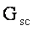
Solar Constant
Solar Constant = Solar radiation intensity upon a surface normal to sun ray and at outer atmosphere (when the earth is at its mean distance from the sun).
The rate of which solar energy arrives at the top of the atmosphere is called solar constant.

Slide 14
Solar Radiation Types:
Solar Radiation
Beam Radiation
Diffuse Radiation

Slide 15
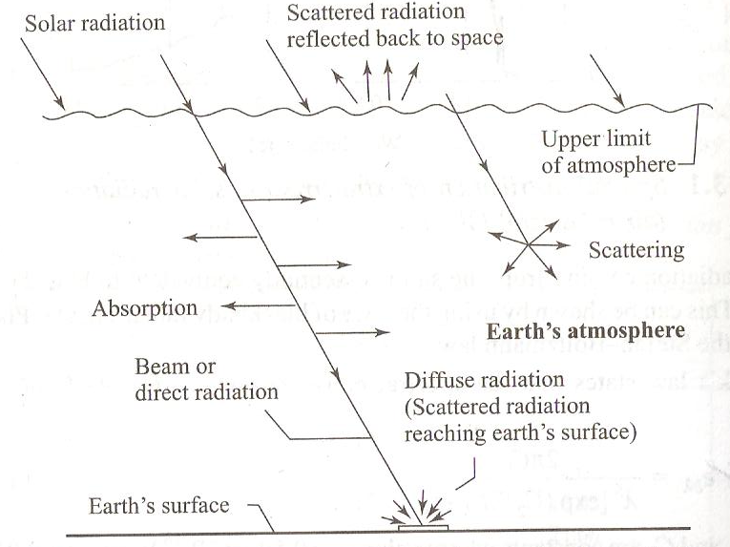
Radiation at Earth’s Surface:

Slide 16
Attenuation of Beam Radiation
Attenuation - gradual loss in intensity
Absorption:
Short wave ultraviolet rays absorbed by ozone
Long wave infrared waves are absorbed by CO₂ and moisture
Due to this bandwidth narrowing of solar radiation.
Range of solar energy is in the range of 0.29 μ to 2.5 μ which received by earth
Scattering:
Scatter a portion of the radiation occurs when solar radiation passes through earth atmosphere due to water vapor and dust. It is called diffuse radiation.

Slide 17
Sun at Zenith : Position of the sun directly over head Air mass (m) : It is the path length of radiation through the atmosphere, considering the vertical path at sea level as unity. At sea level m=1, when sun is at zenith m=2 when zenith angle is 60° m=secƟz, when m>3 where, Ɵz is Angle subtended by the zenith m=0, just above the earth’s atmosphere.

Slide 18
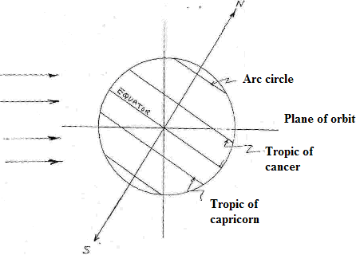
Basic Earth-Sun Angles
Sun’s Ray
Time
The earth is divided into 360º of circular arc by longitudinal lines passing through poles.
The zero longitudinal line passes through Greenwich, England.
Since the earth takes 24 hours to complete rotation, 1 hour = 15º of longitude
What it means?
A point on earth surface exactly 15º west of another point will see the sun in exactly the same position after one hour.
The position of a point P on earth's surface with respect to sun's ray Is known at any instant if following angles are known:
Latitude (l), Hour angle (h)
and Sun’s declination angle (d) .

Slide 19
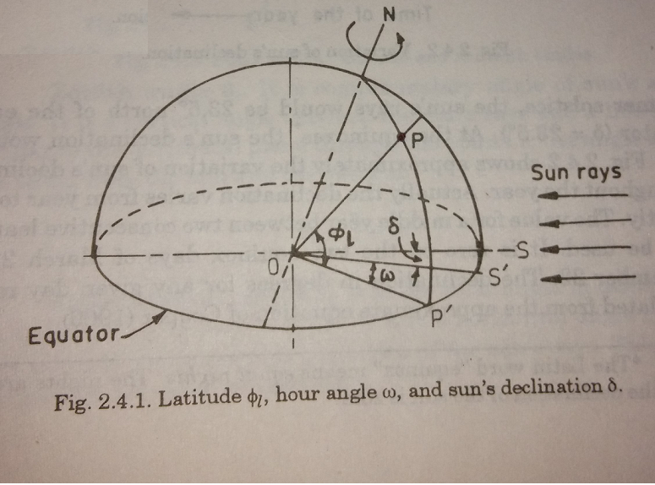
Solar and Wall Angles
Following solar and wall angles are needed
for solar radiation calculation:
Latitude angle, Øl
Sun's Zenith angle , Ɵz
Altitude angle, α
Solar Azimuth angle, γS
Surface Azimuth angle, γ
Sun’s incidence angle, θ
Slope, s
hour angle, ω
Declination angle, δ

Slide 21
Sun’s incidence angle, θ is the angle between an incident beam radiation and the normal to the plane surface.
Latitude angle, Øl of a point or location is the angle made by the radial line joining the location to the center of the earth with the projection of the line on the equatorial plane.
Declination angle, δ is the angular distance of the sun’s rays north (or south) of the equator. It is the angle between a line extending from the center of the sun to the center of the earth and the projection of this line upon the earth’s equatorial plane. In June δ=23.5° and in December δ= -23.5°.
Hour angle, ω is the angle through which the earth must turn to bring the meridian of a point directly in line with the sun’s rays. This angle is equivalent to 15° per hour.

Slide 23
Altitude angle, α is a vertical angle between the projection of the sun’s rays on the horizontal plane and the direction of sun’s rays (passing through the point).
Sun's Zenith angle , Ɵz is complimentary angle of sun’s altitude angle. It is a vertical angle between the sun’s rays and a line perpendicular to the horizontal plane through the point i.e. the angle between the beam from the sun and the vertical. Ɵz = (Π/2)- α
Solar Azimuth angle, γS is the solar angle in degrees along the horizon east or west of north or it is a horizontal angle measured from north to the horizontal projection of the sun’s rays.
Slope, s is the angle made by the plane surface with the horizontal.
Surface Azimuth angle, γ is the angle of deviation of the normal to the surface from the local meridian, at zero point being south, east positive and west negative.

Slide 24
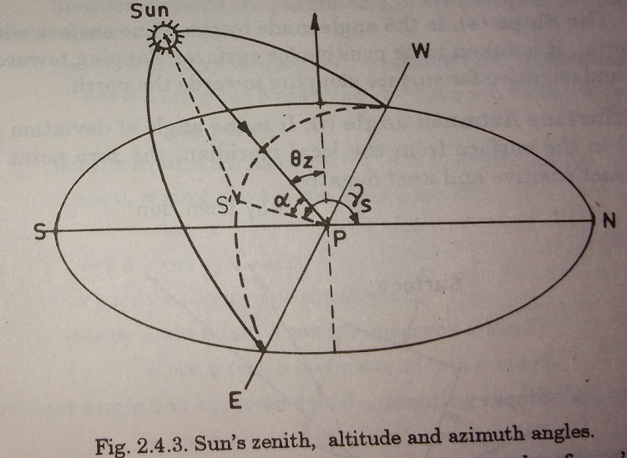

Slide 25
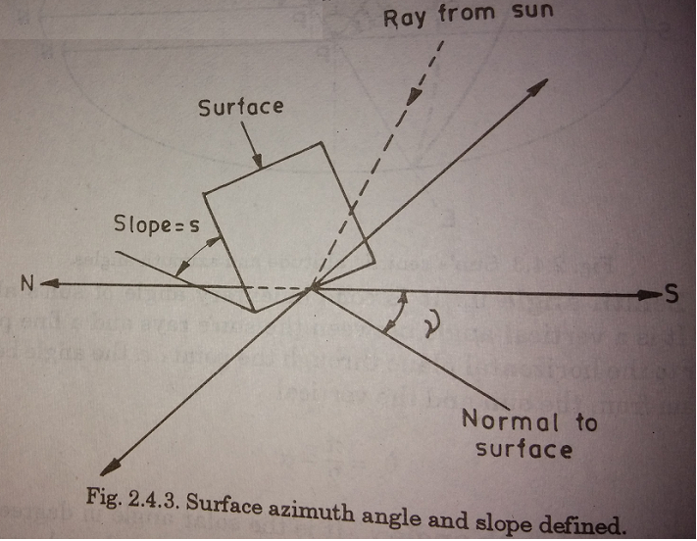

Slide 26
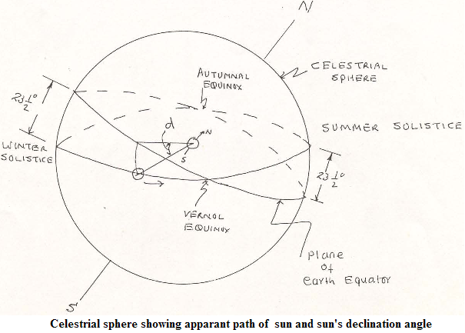
Declination (d)
Angle between a line extending from the center of the sun to the center of the earth and the projection of this line upon the earth equatorial plane.
It is the angular distance of the sun's rays north (or south) of the equator.
Figure shows the sun's angle of declination.
d = - 23.5º C at winter solstice, i.e. sun's rays would be 23.5 º south of the earth's equator
d = +23.5 º at summer solstice, i.e. sun's rays would be 23.5 º north of the earth's equator.
d = 0 at the equinoxes
d = 23.45 sin [360(284+n)/365]

Slide 27
Hour Angle: 'h'
Hour Angle is defined as the angle measured in
the earth's equatorial plane between the projection
of op and the projection of a line from center of the
sun to the center of earth.
- At the solar room, the hour angle (h) is zero,
Morning: negative and Afternoon: positive
The hour angle expresses the time of the day with respect to solar noon.
One hour time is represented by 360/24 or 15 degrees of hour angle

Slide 28
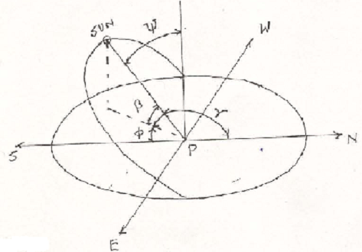
SOLAR ANGLES
Sun
ψ = Zenith Angle = Angle between sun's ray and a line perpendicular to the horizontal plane at P.
β = Altitude Angle = Angle in vertical plane between the sun's rays and projection of the sun's ray on a horizontal plane.
It follows β + ψ =π/2
= Azimuth angle = Angle measured from north to the horizontal projection of the sun's ray.
= Azimuth Angle = angle measured from south to the horizontal projection of the Sun’s ray.

Slide 29
Solar Angles
From analytical geometry
Sun’s zenith angle
cos (ψ) = cos (l) cos(h)cos(d)
+ sin (l) sin (d)
Also β = π/2 - ψ
Sun’s altitude angle:
sin (β) = cos (l) cos (h) cos (d )
+ sin (l) sin (d)
Sun's azimuth ( ) is given by
cos ( ) = sec (β){cos (l) sin (d)
-cos (d) sin (l) cos (h)}
Or
Cos = (sin β sin l – sin d )/(cos β cos l)

Slide 30
Angle of Incidence (θ)
Angle of incidence is the angle between the sun's rays and normal to the surface
cos θ = cosβ cos sinα + sinβ cosα
For vertical surface
cos θ = cos β cos , α = 90°
For horizontal surface
cos θ = sinβ, α = 0°

Slide 31
Local Civil Time (LCT)
Universal Time or Greenwich Civil Time (GCT)
Greenwich Civil Time: GCT time or universal time
Time along zero longitude line passing through Greenwich, England. Time starts from midnight at the Greenwich
Local Civil Time (LCT)
Determined by longitude of the observer. Difference being 4 minutes of time for each degree or 1-hr for 15 °
Example: What is the LCT at 75° degree west longitude corresponding to 12:00 noon at GCT
75° degree corresponds to 75 ° / 15 ° = 5 hours
LCT at 75° degree west longitude = 12:00 PM – 5 hrs= 7 AM

Slide 32
Standard Time
Local civil time for a selected meridian near the center of the zone. Clocks are usually set for the same time throughout a time zone, covering approximately 15° of longitude.
Example
For U.S.A different standard time is set over different time zone based on the meridian of the zone. Following is a list of meridian line.
EST (Eastern Standard Time): 75°
CST (Central Standard Time): 90°
MST (Mountain Standard Time): 105°
PST (Pacific Standard Time): 120°

Slide 33
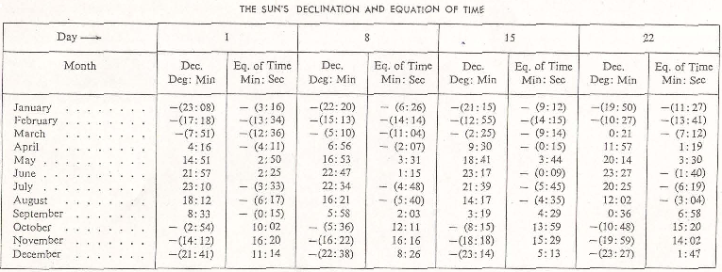
Equation of Time and Sun’s Declination Angle

Slide 34
Solar Radiation Intensity at Earth Surface
Solar radiation incident on a surface at earth has three different
components:
1. Direct radiation:
The solar radiation received from the sun without having
been scattered by the atmosphere.
2. Diffuse radiation:
Radiation received and remitted in all directions by earth
atmosphere:
3. Reflected radiation:
Radiation reflected by surrounding surfaces.

Slide 36
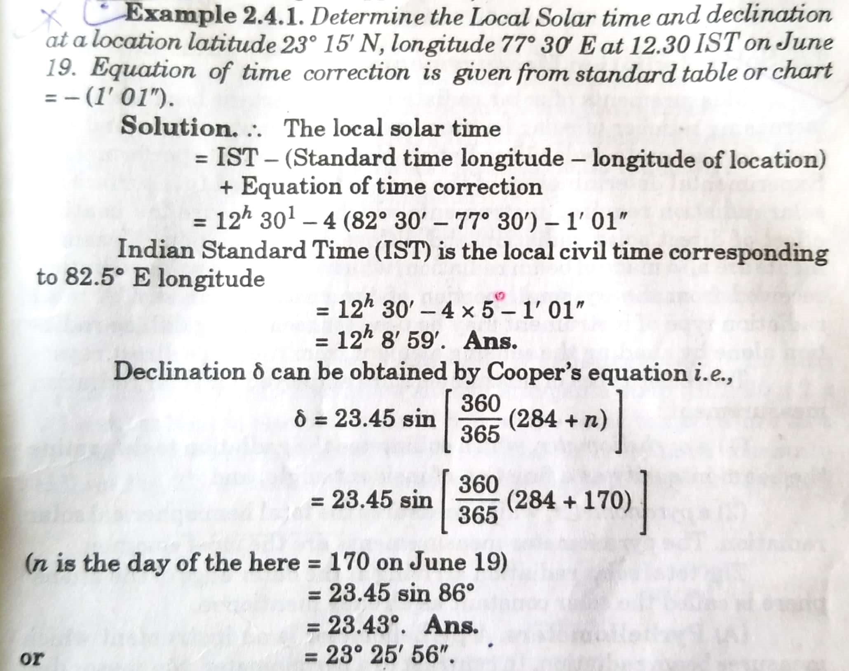

Slide 37
Solar Radiation Measurement
Pyrheliometer
pyranometer

Slide 38
Measurement of Solar Radiation
Definitions
Everything in nature emits electromagnetic energy, and solar radiation is energy emitted by the sun.
The energy of extraterrestrial solar radiation is distributed over a wide continuous spectrum ranging from ultraviolet to infrared rays.
In this spectrum, solar radiation in short wavelengths (0.29 to 3.0 μm) accounts for about 97 percent of the total energy.
Direct solar radiation is observed from sunrise to sunset, while global solar radiation is observed in the before sunrise and after sunset, despite its diminished intensity at these times.

Slide 39
Measurement of Solar Radiation
Units
The solar irradiance is expressed in watts per square meter (W/m²) and the total amount in joules per square meter (J/m²).
Solar irradiance: 1 kW/m² = 1.433 cal/cm²/min
Total amount of solar radiation: 1 MJ/m² = 23.89 cal/cm²
In Japan, the total amount of global solar radiation per day is about 20 MJ/m² in the summer in Okinawa and about 5 MJ/m² in the winter along the Sea of Japan.
The value of direct solar irradiance is about 120 W/m² at around sunrise and sunset, and about 800 W/m² at around noon on a clear day in summer.

Slide 40
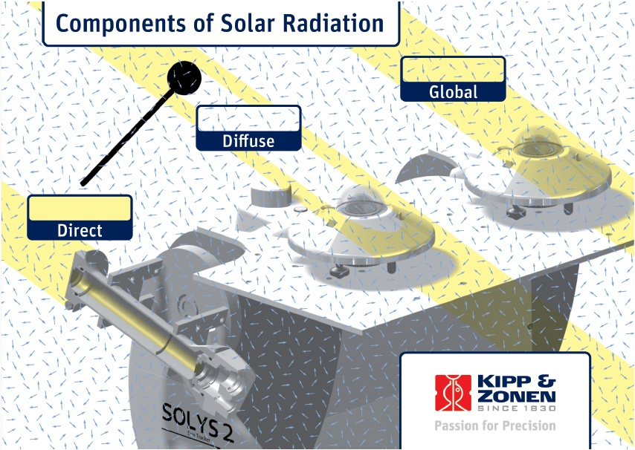
Pyrheliometer
Which collimates the radiation to determine the beam intensity as a function of incident angle
Pyranometer
Which measures the
total hemispherical solar
radiation

Slide 41
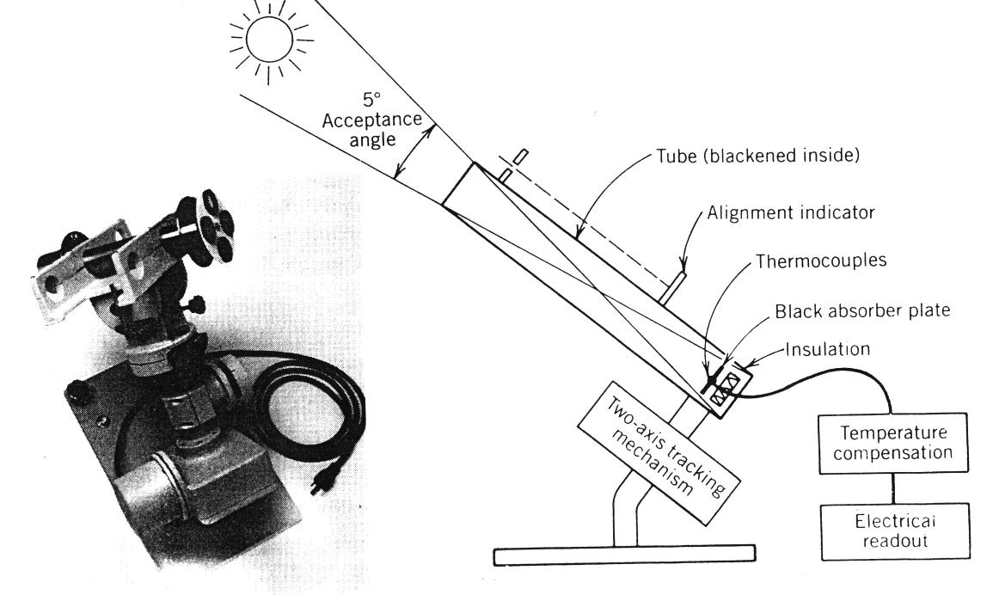
A pyrheliometer is an instrument that measures the direct component of the solar beam at normal incidence. Therefore a pyrheliometer must be mounted on a device called a solar tracker that orients the pyrheliometer perpendicular to the solar beam during the day.
For the measurement of Beam/Direct Radiation
Notes:
41

Slide 42
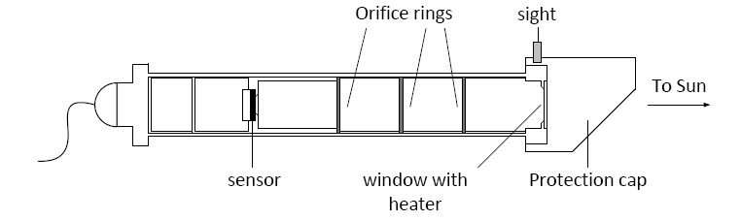

Slide 43
Types of pyrheliometer: (1) The angstrom pyrheliometer (2) The abort silver disc pyrheliometer (3) Eppley pyrheliometer

Slide 44
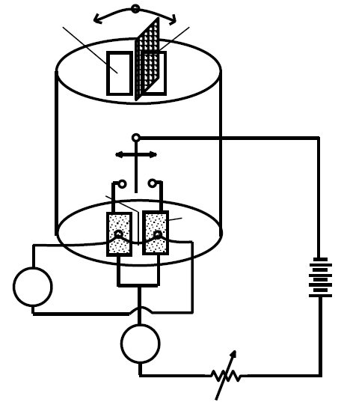
The angstrom pyrheliometer
This pyrheliometer has a rectangular apparatus, two manganin-strip sensors (20.0 mm × 2.0 mm × 0.02 mm) and several diaphragms to let only direct sunlight reach the sensor.
The sensor surface is painted optical black and has uniform absorption characteristics for short-wave radiation.
A copper-constantan thermocouple is attached to the rear of each sensor strip, and the thermocouple is connected to a galvanometer.
When solar irradiance is measured with this type of pyrheliometer, the small shutter on the front face of the cylinder shields one sensor strip from sunlight, allowing it to reach only the other sensor.
A temperature difference is therefore produced between the two sensor strips because one absorbs solar radiation and the other does not, and a thermoelectromotive force proportional to this difference induces current flow through the galvanometer.
Switch
Galvanometer
Variable resistor
Then, a current is supplied to the cooler sensor strip (the one shaded from solar radiation) until the pointer in the galvanometer indicates zero, at which point the temperature raised by solar radiation is compensated by Joule heat.
A value for direct solar irradiance is obtained by converting the compensated current at this time.

Slide 45
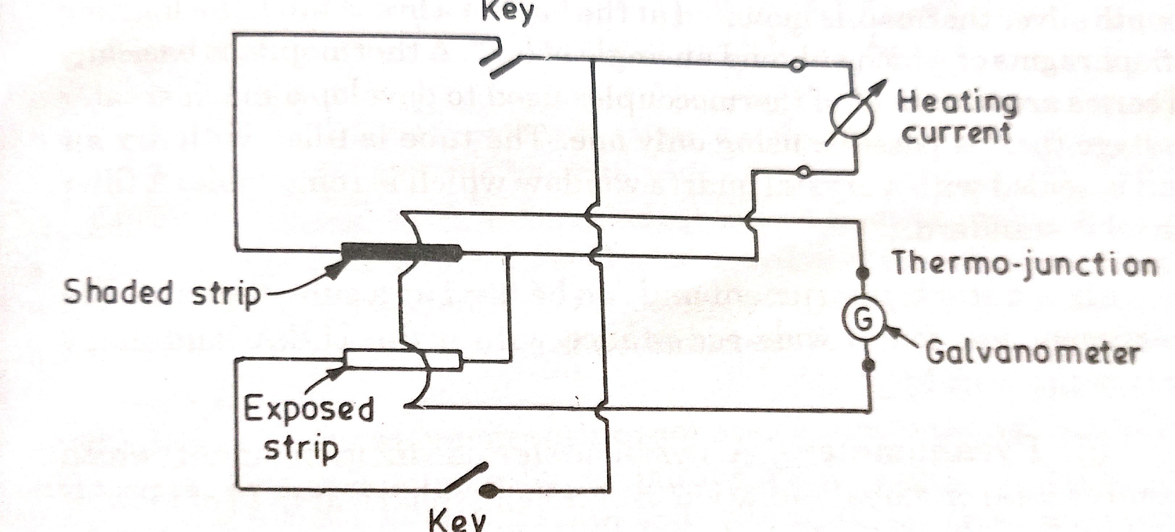

Slide 46
The energy H of direct radiation is calculated by means of the formula,
H_{DN}=Ki²
Where,
H_{DN} = Direct radiation incident on an area normal to the sun’s rays
I = heating current in amperes
K= dimension and instrument constant
= R/Wα
Where,
R = resistant per unit length of the absorbing strip (Ω/cm)
W = mean width of the absorbing strip
α = the absorbing coefficient of the absorbing strip

Slide 47
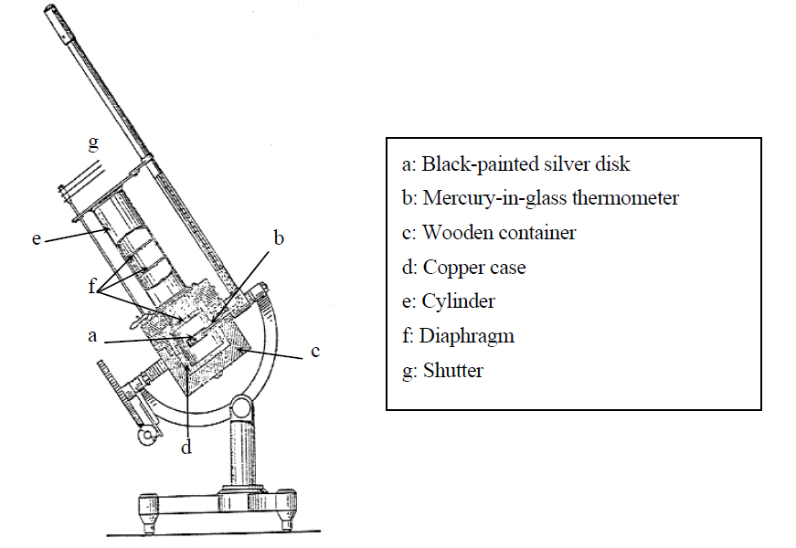
The abort silver disc pyrheliometer

Slide 48
The sensing element is a silver disk measuring 28 mm in diameter with a thickness of 7 mm that is painted black on its radiation-receiving side.
It has a hole from the periphery toward the center to allow insertion of the bulb of a high-precision mercury-in-glass thermometer.
To maintain good thermal contact between the disk and the bulb, the hole is filled with a small amount of mercury.
It is enclosed outside by a heat-insulating wooden container.
The stem of the thermometer is bent in a right angle outside the wooden container and supported in a metallic protective tube.
A cylinder with diaphragms inside is fitted in the wooden container to let direct solar radiation fall onto the silver disk.
There is a metallic-plate shutter at the top end of the cylinder to block or allow the passage of solar radiation to the disk.
During the measurement phase, the disk is heated by solar radiation and its temperature rises.
The intensity of this radiation is ascertained by measuring the temperature change of the disk between the measurement phase and the shading phase with the mercury-in-glass thermometer.

Slide 49
Eppley pyrheliometer
The sensitive element in an eppley pyrheliometer is a temperature compensated 15 junction bismuth silver thermopile mounted at the base of a brass tube, the limiting diaphragms of which subtend an angle 5.7°.
A thermocouple is basically a series arrangement of thermocouples used to develop a much greater voltage then is possible using only one. The tube is filled with dry air and is sealed with a crystal quartz window which is removable.
Used as a sub standard
Wide acceptance in USA and many other parts of the world

Slide 50
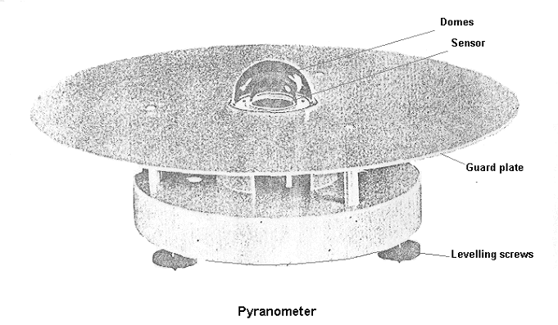
Measurement Devices
Pyrenometer
To measure Global Radiation
Notes:
50

Slide 51
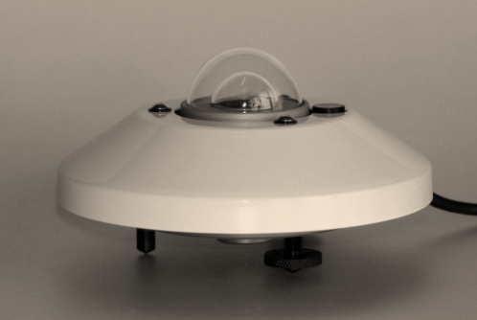
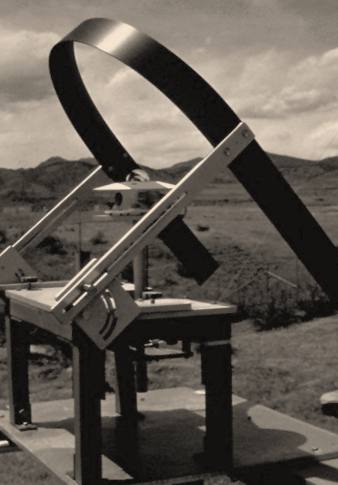
Pyrenometer with Shading Ring for
Diffused Radiation Measurements
Notes:
51

Slide 52
Types of pyranometer: (1) Eppley pyranometer (2) Yellot solarimeter (photo-voltaic solar cell) (3) Moll-Gorczyheski solarimeter (4) Bimetallic Actionographs of Rabitzsch type (5) Velochme pyranometer (6) Thermolelectric pyranometer

Slide 53
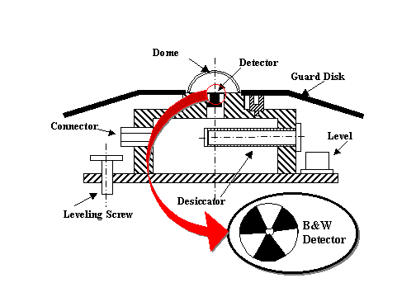
Eppley pyranometer
The Black and White (B&W) pyranometer is an instrument designed to measure diffuse broadband solar irradiance.
It is based on principle as there is difference between the temperature of black surface and white surface.
The detection of temperature difference is achieved by thermopile.
Uses concentric silver rings 0.25 mm thick coated B&W
Circular pattern

Slide 54
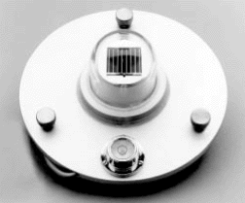
Yellot solarimeter (photo-voltaic solar cell)
The sensor is a silicon photovoltaic cell which absorbs radiation from 0.35 to 1.15 microns.
The silicon cell converts this light energy directly into electrical energy, and the output voltage (approximately 70 mV/W/m²) is essentially linear with light intensity.
Full-scale response time is less than 1 millisecond due to the fact that the instrument is light sensitive, not heat sensitive as the thermopile pyranometers are.
If the output is integrated over a daily period, the accuracy of the value is within +/-3%. Accuracy of instantaneous values is +/-5%.
Temperature compensation is provided from 4° to 60°C.

Slide 55
Measurement of Sunshine Duration
Definition
Sunshine duration is the length of time that the ground surface is irradiated by direct solar radiation (i.e., sunlight reaching the earth's surface directly from the sun).
In 2003, WMO (World Meteorological Organization) defined sunshine duration as the period during which direct solar irradiance exceeds a threshold value of 120 watts per square meter (W/m²).
This value is equivalent to the level of solar irradiance after sunrise or before sunset in cloud-free conditions.

Slide 56
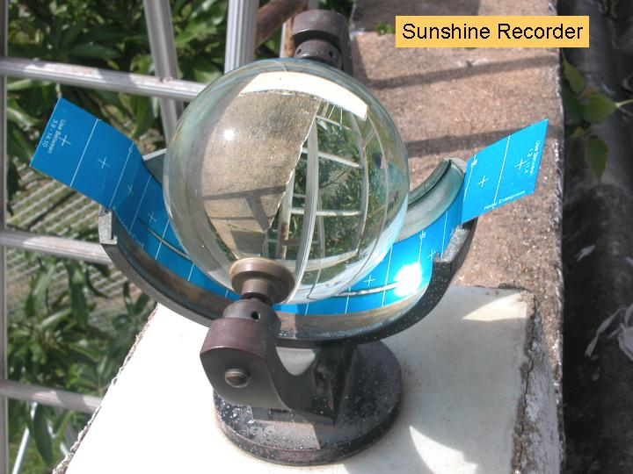
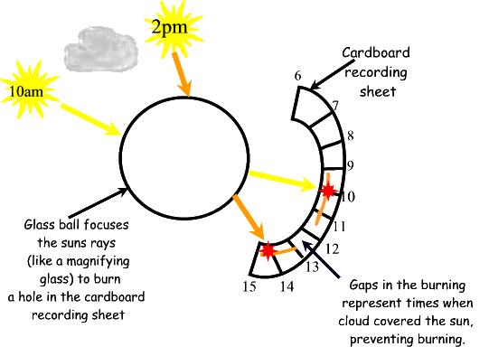
Notes:
56

Slide 57
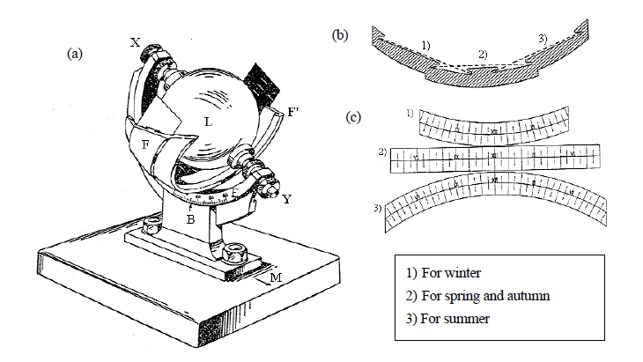
A Campbell-Stokes sunshine recorder concentrates sunlight through a glass sphere onto a recording card placed at its focal point. The length of the burn trace left on the card represents the sunshine duration.

Slide 58
A homogeneous transparent glass sphere L is supported on an arc XY, and is focused so that an image of the sun is formed on recording paper placed in a metal bowl FF' attached to the arc.
The glass sphere is concentric to this bowl, which has three partially overlapping grooves into which recording cards for use in the summer, winter or spring and autumn are set.
Three different recording cards are used depending on the season.
The focus shifts as the sun moves, and a burn trace is left on the recording card at the focal point.
A burn trace at a particular point indicates the presence of sunshine at that time, and the recording card is scaled with hour marks so that the exact time of sunshine occurrence can be ascertained.
Measuring the overall length of burn traces reveals the sunshine duration for that day.
For exact measurement, the sunshine recorder must be accurately adjusted for planar leveling, meridional direction and latitude.
Campbell-Stokes and Jordan sunshine recorders mark the occurrence of sunshine on recording paper at a position corresponding to the azimuth of the sun at the site, and the time of sunshine occurrence is expressed in local apparent time.

Slide 59
Solar Radiation Data
India lies between latitude 7° and 37°
Annual average intensity 16700-29260 kJ/m2/day
Peak value in April or May, Gujarat-Rajasthan over 25100 kJ/m2/day
During monsoon about 16700 kJ/m2/day
Annual daily diffuse radiation 7300 kJ/m2/day
Minimum radiation in November-December- 3135-4180 kJ/m2/day and at that time maximum radiation occur in Gujarat around 12550 kJ/m2/day

Slide 60
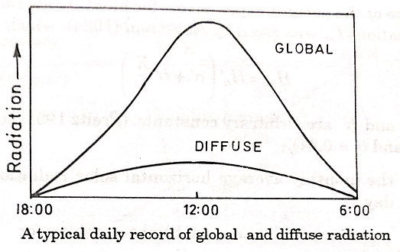

Slide 61
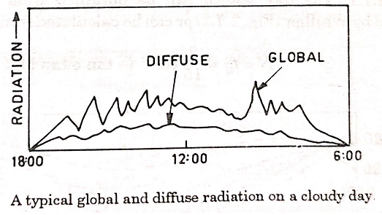

Slide 62
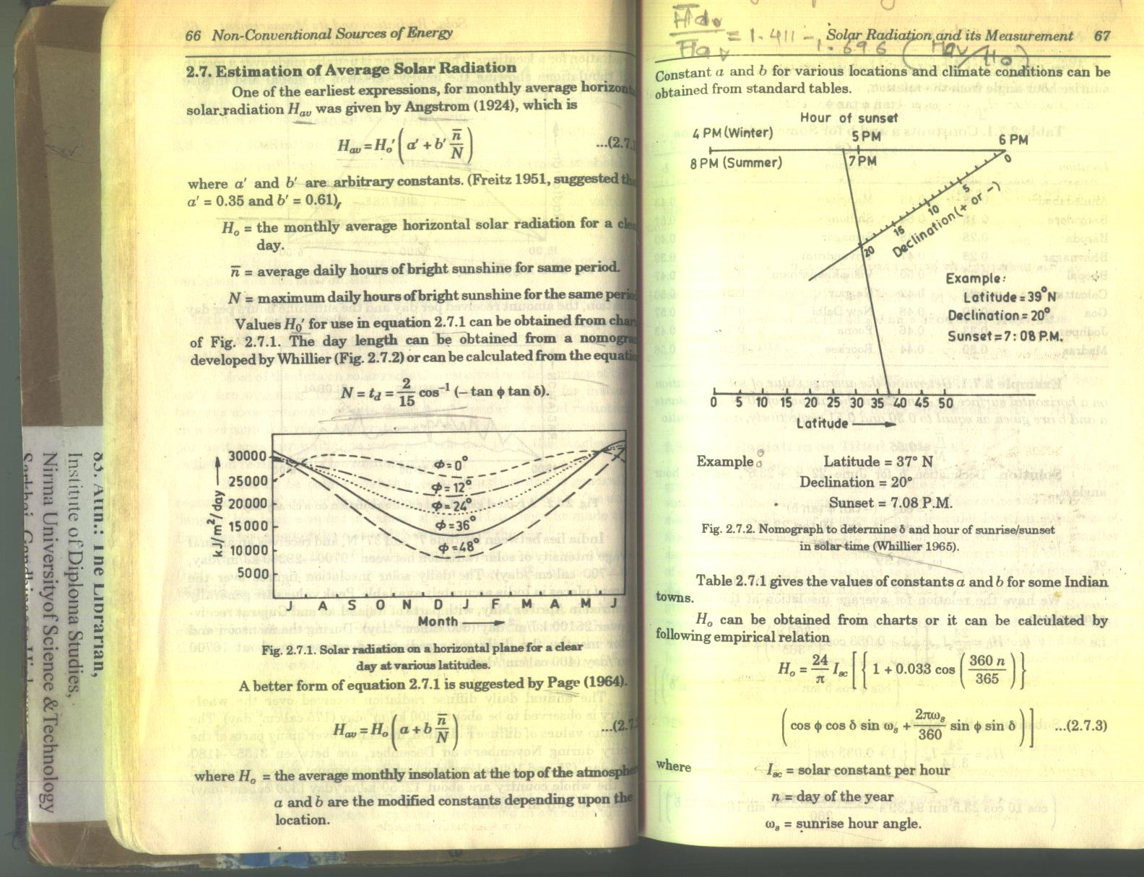

Slide 63
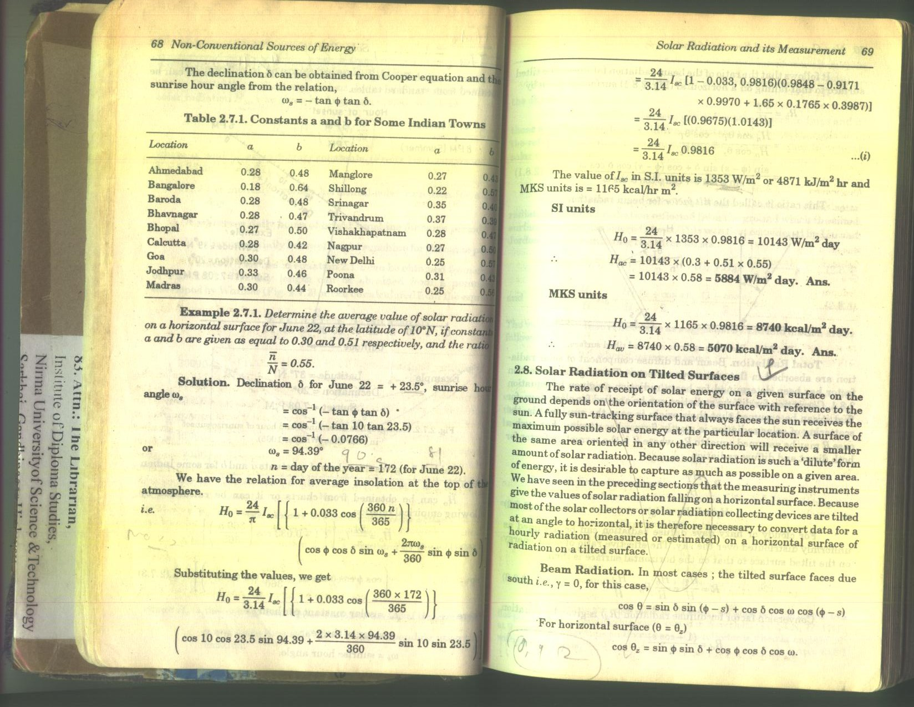

Slide 64
